Slide 1
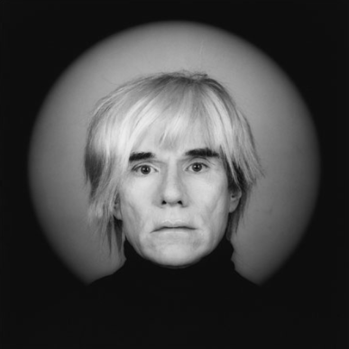
Andy Warhol
Pop Art

Slide 2
Who was Andy Warhol?
His works explore the relationship between artistic expression, celebrity, culture and advertising that flourished by the 1960s
Lived August 6, 1928 – February 22, 1987
Most active during the 1960’s where he was part of the celebrity culture at the time

Slide 3
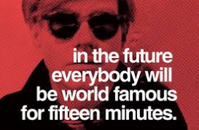
Famous Quotes

Slide 4
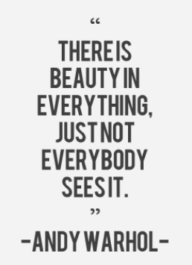
Famous Quotes

Slide 5
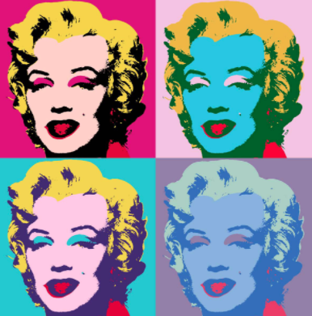
Pop Art

Slide 6
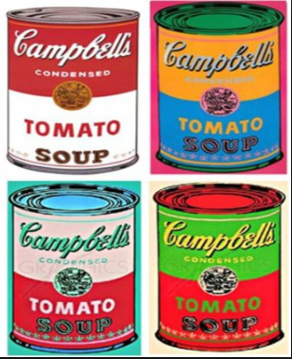
Pop Art

Slide 7
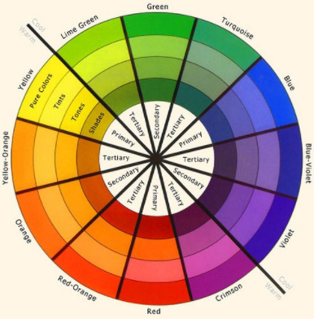
Learning Goal and Success Criteria
To create pop art with a 2017 theme and to show understanding of the colour wheel.
I can choose a simple image that is popular today.
I can duplicate the 4 times on a page.
I can colour each of the four images in a different colour grouping from the colour wheel (ex. Primary colours, tertiary colours, pairs of complementary colors, warm colour or cool colours)

Slide 8
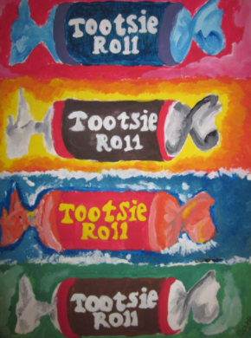
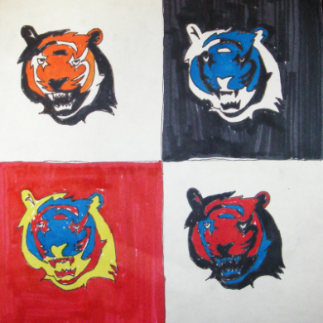
Examples

