Slide 1
Evolution of Dance Project

Slide 2
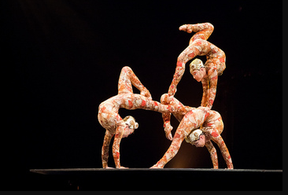
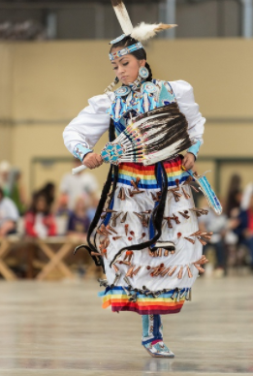
Elements of Dance
• BODY
body awareness, use of body parts, body shapes, locomotor and non-locomotor movements, body bases, symmetry versus asymmetry, geometric versus organic shape, angular versus curved shape

Slide 3
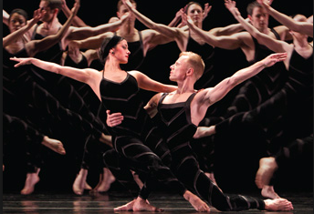
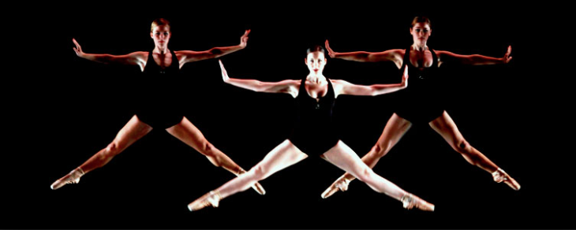
ELEMENTS OF DANCE CONT.
• space: levels, pathways, directions, pattern, positive versus negative space, various group formations, proximity of dancers to one another

Slide 4
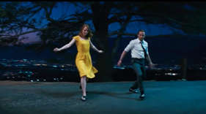
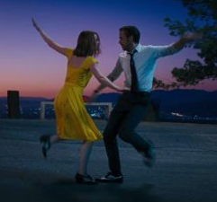
Elements of dance cont.
• time: tempo, rhythm (e.g., regular, irregular), pause, stillness, with music, without music, duration

Slide 5
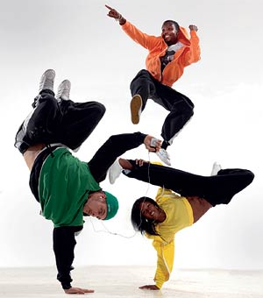
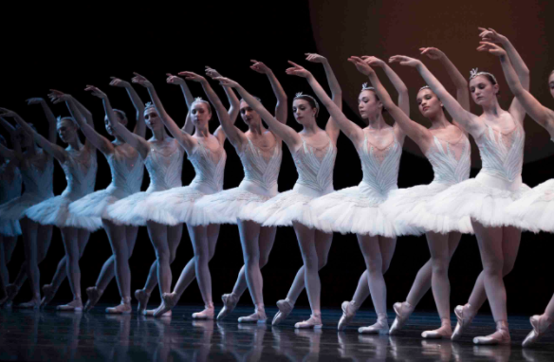
Elements of dance cont.
• energy: effort, force, quality (e.g., slash, press, shrink, open)

Slide 6
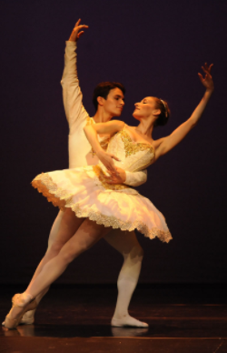
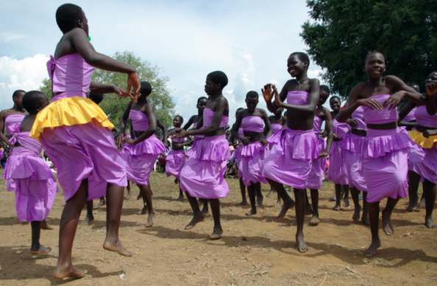
Elements of dance cont.
• relationship: meet/part, follow/lead, emotional connections between dancers, groupings

Slide 7
Evolution of dance

Slide 8
What are different types/ eras of dance?
TYPES | ERAS

Slide 9
Learning goal and success criteria
Learning Goal
To demonstrate understanding of a type of dance from a specific time period or place.
Success Criteria
I can watch different dance videos and identify where and when they originated.
I can choose a style or type of dance from a specific time period, dancer or place.
I can research how the dance started, where it was popular and describe its impact/ importance in a written report.
I can learn dance steps and perform them.
I can reflect on my strengths and areas of growth as a dance creator and audience member in a self-assessment.

